Slide 1
Elementary UDP Sockets
Unix Network Programming
Ch # 8

Slide 2
UDP Sockets
There are fundamental differences between apps written using TCP vs. those that use UDP sockets
  because of differences in the two transport layers:
    UDP is connectionless, unreliable, datagram
    quite unlike TCP connection-oriented, reliable, streams

Slide 3
Typical UDP client/server
fig 8.1, pg 240
Client does not establish a connection to the server
  client just sends a datagram to the server using sendto() function
  similarly, server does not accept a connection from client, instead simply calls recvfrom() function which waits for data to arrive

Slide 4
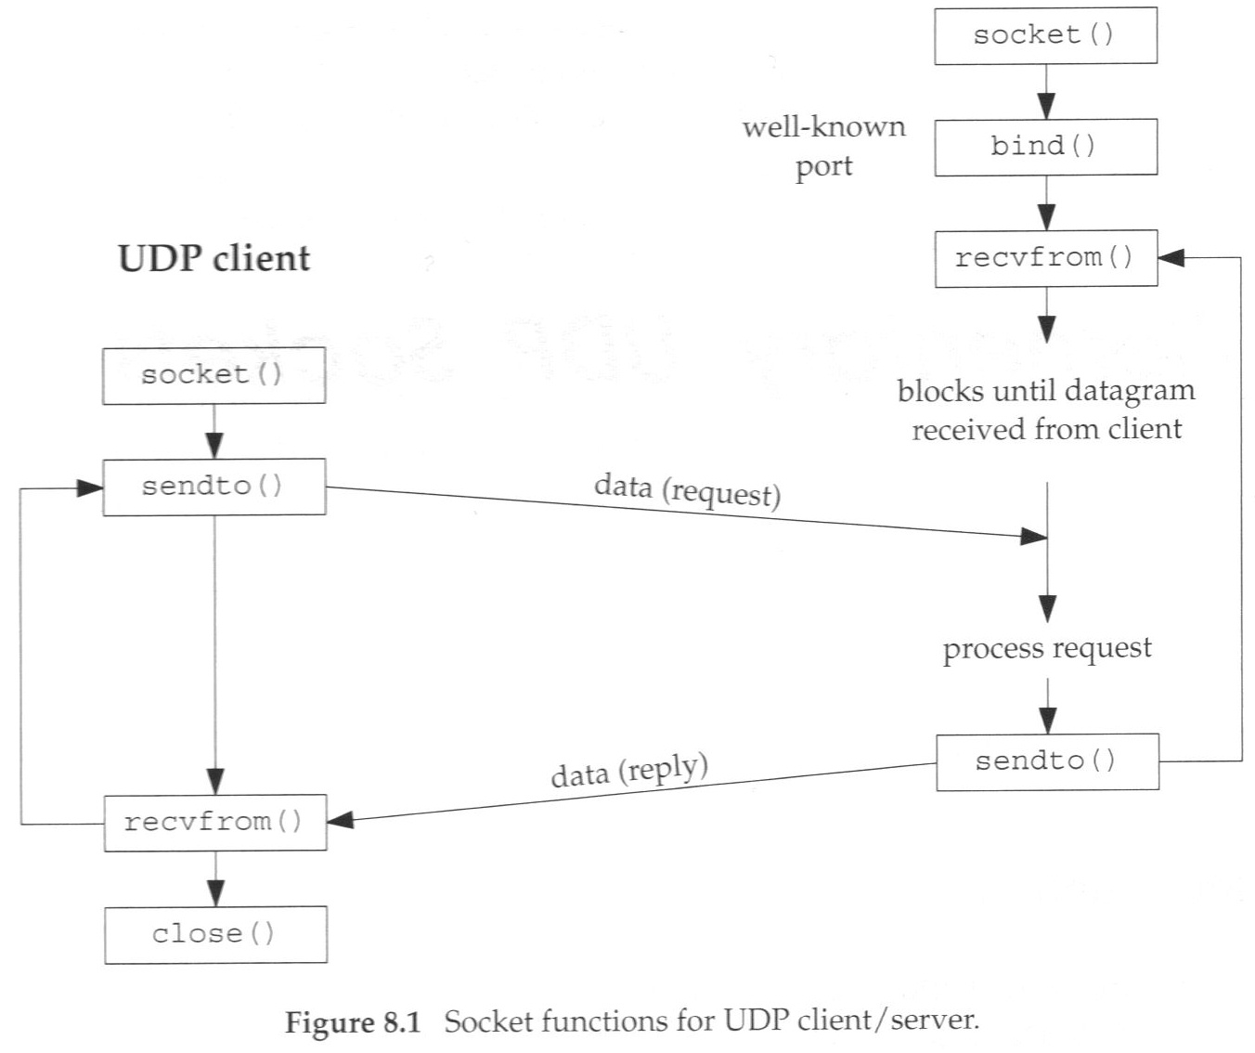
Typical UDP Client/Server

Slide 5
recvfrom and sendto functions
Similar to standard read/write functions, but with 3 additional arguments:
#include <sys/socket.h>
ssize_t recvfrom(int sockfd, void *buff, size_t nbytes, int flags,
struct sockaddr *from, socklen_t *addrlen);
ssize_t sendto(int sockfd, const void *buff, size_t nbytes, int flags,
const struct sockaddr *to, socklen_t addrlen);
Both return: number of bytes read or written if OK, -1 on error
we can set flags to 0 for simple udp sockets we will see
besides flag, need a sockaddr and length of the structure, of where to send or where data received from

Slide 6
UDP Client/Server
Echo Server UDP version

Slide 7
UDP Servers
server (dg_echo) never terminates
  UDP is connectionless, there is nothing like EOF as we have with TCP
It is an iterative server, not a concurrent server
  No call to fork
  single server process handles any and all clients
  generally TCP servers are concurrent and UDP are iterative
  implied queuing in UDP layer handles cases of multiple clients.

Slide 8
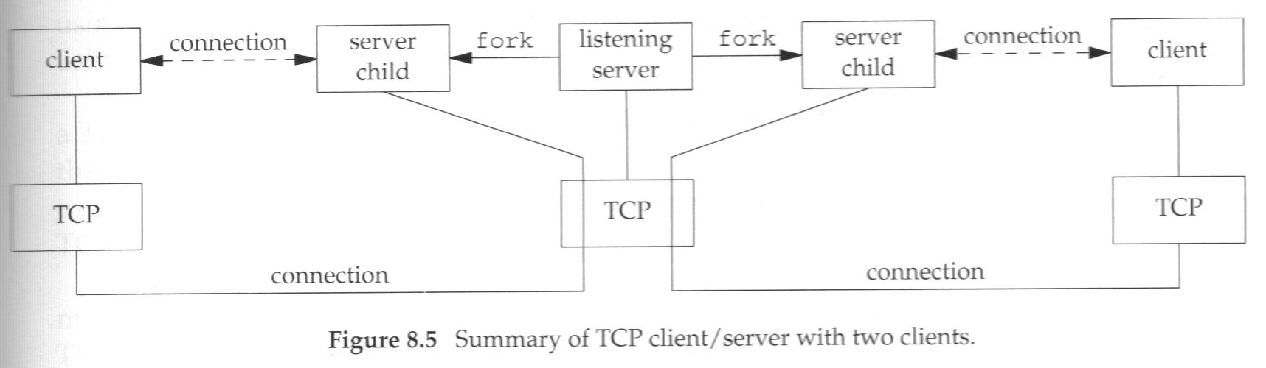
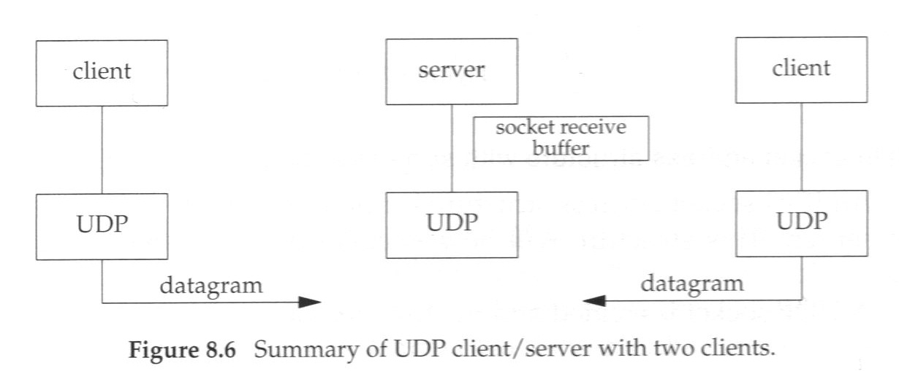
UDP Servers

Slide 9
Echo Client UDP version

Slide 10
Lost Datagrams
UDP client/server example is not reliable
If client datagram is lost, client will block forever waiting for server reply
Same thing if the server datagram reply is lost, client is again blocked.
Typical way to prevent is place a timeout on clients recvfrom.
  But can't tell which situation occurred, was the clients request lost, or was it processed and simply the server's reply lost
  Can make a big difference, for example if the application is a banking request to make a deposit rather than a simple echo server.

